Slide 1
Logistics Research Papers Classification
By Iffan Kepan

Slide 2
Table of contents
01
Introduction
02
Methodology
03
Summary
Overview of the problem and the project's objectives.
Processes and techniques used to conduct the research.
Key findings from models and future development.

Slide 3

01
Introduction

Slide 4


Do you ever struggle with finding documents?
where is the document?
Notes:
Is there anyone here who works or stores all files in a single folder? No one, right? Why is that? Because it’s hard to find files, and it takes a lot of time.
The Downloads folder — I believe many people have faced the issue of finding files in there. Sometimes, after downloading a file, we forget to move it to a folder we regularly use, and we end up scrolling down to find it, which can take a long time. It's similar to a library or supermarket without signs indicating product categories. If that were the case, finding items would be difficult and time-consuming.

Slide 5



Life is better when...
Notes:
Organizing files by their usage type makes it much easier to use and find them, just like how everyone organizes their own data or files into a well-structured format.

Slide 6
Problem Statement
“
Students face significant difficulty in finding literature reviews or research papers from their seniors, as there is no categorization of research work, and all papers are stored in a single folder.
“

Slide 7






What is the criteria to classify ?
Demand Planning
Procurement
and Sourcing
After Sales Services
Supply Chain
Key Processes
Manufacturing
and Production
Import - Export
Distribution and
Transportation
Warehouse
and Inventory
Management

Slide 8

02
Methodology

Slide 9
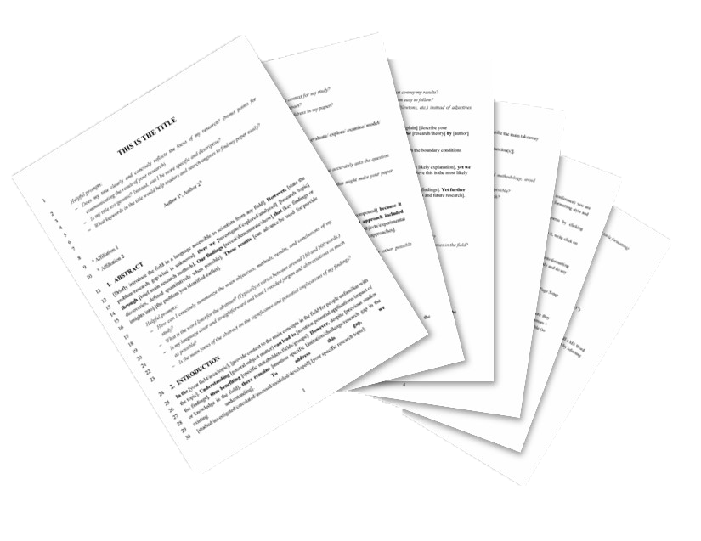

Data Collection
ก-ฮ
Students
Language
The data comes from logistics bachelor's degree students.
All documents are written in Thai.
Dataset
Size
The dataset includes a total of 340 files.
Each file contains
an average of 6 pages.
Notes:
The data comes from logistics bachelor's degree students.
All documents are written in the Thai language.
The dataset includes a total of 340 files.
Each file contains an average of 6 pages.

Slide 10
Category Distribution
Warehouse and Inventory Management is the most topic with 102 papers (30% of the total 340 files).
While After Sales Service has the fewest papers with only 15.
Train/Test with 70%/30%

Slide 11
Flow of Process
Tokenization
Model Training
Used two Thai tokenizers:
Newmm, WangchanBERTa
Compared 4 models:
Neural Network, SVM,
Gradient Boosting, Naive Bayes
ฉัน | รัก |
การอ่าน |
หนังสือ
Raw Data
TF-IDF Vectorization
Evaluation
Plain text from Research paper
Tested different parameters:
max features: 5000, 7000, None
max df: 0.9, 0.8
Measured performance using Accuracy
Notes:
NLP stands for Natural Language Processing, a field of AI that helps computers understand, interpret, and respond to human language.
TF-IDF helps us identify which words stand out in a document by combining how frequently a word appears in the document with how rare the word is across all documents.It’s like figuring out which words are most "important and unique" to the context of each document.

Slide 12
Performance Comparison
Newmm performs better than WangchanBERTa in many models except SVM where both have the same score.
Notes:
Summary: Newmm outperforms WangchanBERTa in many models, except for SVM, where both yield similar results. This is because Newmm tokenizes words individually, which suits simpler models like Neural Networks, allowing them to learn from word-level features more effectively.
A significant advantage of Newmm is the ability to customize its dictionary, making it ideal for domain-specific tasks where precise terminology is essential. By adding custom words, Newmm can better handle specialized vocabulary, which is particularly useful in contexts like logistics research papers.
Insight: Newmm is beneficial for tasks requiring word-level feature extraction, while WangchanBERTa excels at understanding word context. For research papers with specialized terms, Newmm's customizability offers a clear advantage, while WangchanBERTa's contextual focus may struggle with such precise language.
Insight :
Newmm is better for tasks where word-level features are important.
While WangchanBERTa considers the context of words.

Slide 13
Performance Comparison (2)
Constraining Max DF to 0.9 marginally improves Neural Network performance, but has no significant impact on other models.
Neural Network benefits most from constraining Max Features to 5000,
while other models remain unaffected.
Notes:
Observation:
Neural Network performs the best, with accuracies of 0.68 and 0.69 for Max DF values of 0.8 and 0.9, respectively.
SVM has a consistent performance of 0.51 for both Max DF settings.
Gradient Boosting achieves 0.49 for both Max DF values.
Naive Bayes shows lower accuracy, maintaining 0.44 for both Max DF settings.
Insight: The Neural Network model shows sensitivity to changes in the Max DF parameter, while other models remain unaffected.
Observation:
Neural Network achieves the highest accuracy of 0.70 with Max DF set to 5000, but performance drops slightly to 0.68 for 7000 and None.
SVM shows consistent performance (0.51) across all three Max DF settings.
Gradient Boosting also remains stable at 0.49 regardless of the Max DF value.
Naive Bayes achieves 0.44 for all settings.
Insight: Neural Network performance improves slightly when Max DF is constrained to 5000, whereas other models do not benefit from changes in Max DF Neural Networks Can Be More Sensitive to Feature Representation:
Neural Networks, especially deep learning models, tend to perform better with finely tuned feature representations. Even small changes in vectorizer parameters can significantly impact the neural network's ability to learn from the data, especially when it has the capacity to capture more complex patterns.
In contrast, models like Naive Bayes, SVM, and Gradient Boosting might be less sensitive to subtle changes in feature representation because they have different learning mechanisms. Naive Bayes assumes feature independence, SVM focuses on margin maximization, and Gradient Boosting builds an ensemble of decision trees that may not be as sensitive to slight variations in features.
.

Slide 14
Model Evaluation
Neural Network performs the best, with an accuracy of 0.68
Other models like SVM (0.51), Gradient Boosting (0.49), and Naive Bayes (0.44) show lower accuracies.
Notes:
Neural Network performs the best, with an accuracy of 0.68, indicating it is the most effective model for this classification task among the ones listed.
Other models like SVM (0.51), Gradient Boosting (0.49), and Naive Bayes (0.44) show lower accuracies, which means they are not as well-suited for the problem in comparison to the neural network.

Slide 15

03
Summary

Slide 16
Key Findings
Accuracy
Best Performance
Import-Export (92%)
Procurement and Sourcing (89%)
Warehouse and Inventory Management (84%)
71.57 %
Best Combination
Model : Neural Network
Tokenizer : Newmm Tokenizer
max_features = 5000
max_df = 0.9
Challenges
After Sales Service (20%)
Others (38%)
Manufacturing and Production (44%)

Slide 17
Future Development and Recommendations
End-to-end pipeline automates the entire process, from data collection to final output:
Categorization
Summarization
Analysis
Recommender System
Notes:
An end-to-end pipeline automates the entire process, from data collection to final output, eliminating the need for manual intervention. In your logistics research paper classification project, it automates key tasks such as categorization, summarization, analysis, and recommendations.
Categorization: Automatically classify papers into relevant categories (e.g., Procurement, Logistics).
Summarization: Generate brief summaries of each paper, highlighting key themes.
Analysis: Extract insights, trends, and key keywords from the papers for further research.
Recommender System: Suggest papers based on the user’s interests, past searches, or related topics.

Slide 18


Slide 19
Q & A

Slide 20
Thank you

Slide 21

Appendix

Slide 22
Reason for pick models
SVM (Support Vector Machines) :
Handles high-dimensional data well (e.g., text features like TF-IDF).
Effective at separating classes, even for non-linear boundaries.
Neural Networks :
Captures complex and non-linear patterns in data.
Adaptable to diverse data types and structures.
Gradient Boosting (e.g., XGBoost, LightGBM) :
Excels at capturing feature interactions.
Highly accurate and robust for structured classification tasks.
Naive Bayes :
Simple, fast, and interpretable.
Works well for text classification due to its independence assumption.

Slide 23
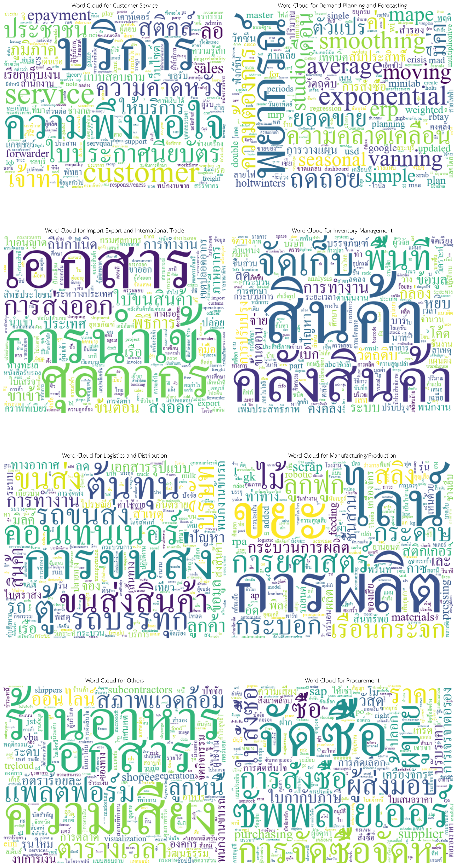
Word cloud

Slide 24
Word cloud

Slide 25
Word cloud

Slide 26
Word cloud

Slide 27
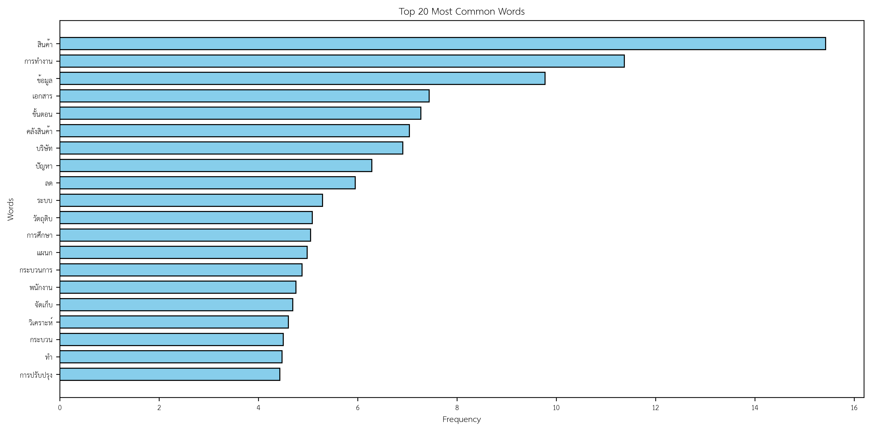
Common Words
สินค้า (product) and การทำงาน (work process) appear the most often, showing their importance in logistics topics.
Other key words like ข้อมูล (data), คลังสินค้า (warehouse), and ปัญหา (problem) reflect themes related to operations, data management, and issue resolution.

Slide 28
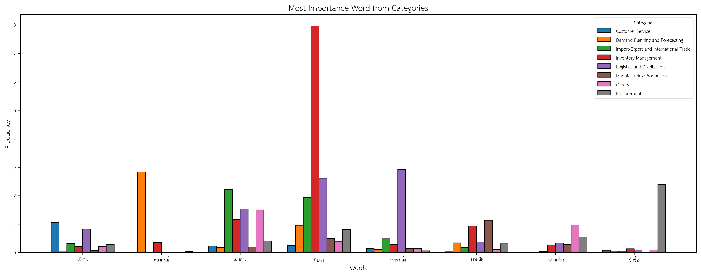
Importance Words

Slide 29
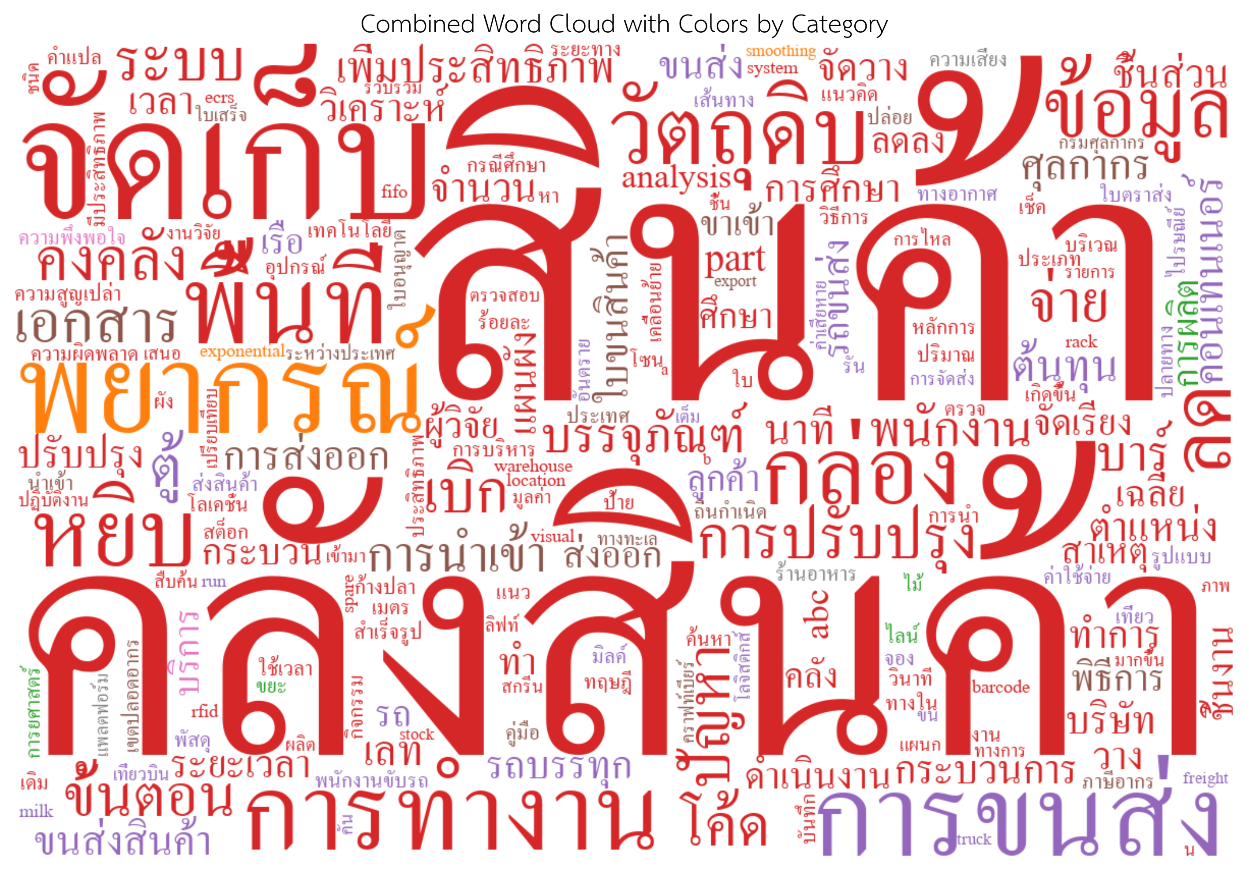

Slide 30
Classification Report
Category | Precision | Recall | F1-Score
After Sales Service | 0.5 | 0.2 | 0.29
Demand Planning | 0.56 | 0.71 | 0.62
Import-Export | 0.79 | 0.92 | 0.85
Warehouse and Inventory Management | 0.76 | 0.84 | 0.8
Distribution and Transportation | 0.68 | 0.71 | 0.7
Manufacturing and Production | 0.67 | 0.44 | 0.53
Others | 0.5 | 0.38 | 0.43
Procurement and Sourcing | 0.89 | 0.89 | 0.89

